Slide 1
Jonathan Swain Technical Director - NFU Energy
Taking the first steps towards Net Zero
Notes:
Taking the first steps towards Net Zero
This last 12 months have seen much discussion about how Net Zero could be achieved, however much of this is aimed at changes taking place on the gas and electricity networks and less about practical steps that individuals can take. In this session Jon will explore what actions growers can take in the first steps towards reducing their carbon footprints and what the future may be for energy supply and consumption.

Slide 2
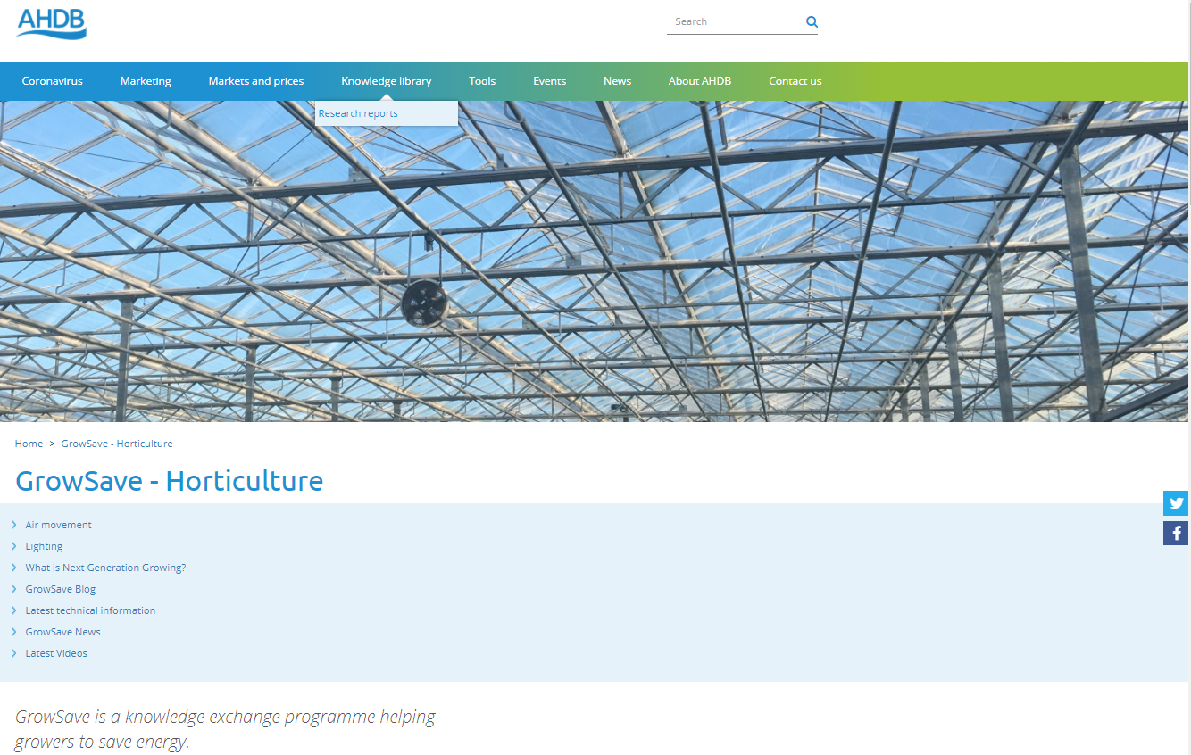

Slide 3
So what is Net Zero?
I = CO₂ emissions increasing the level of CO₂ in the system
Net Zero is when I=S
i.e. emissions into the system (inputs) are equal to emissions out of the system (sequestration)
The removal actions (S) are easier when emissions inputs (I) are lower
Gross Zero is when I=0
CO₂
S = CO₂ removals decreasing the level of CO₂ in the system

Slide 4
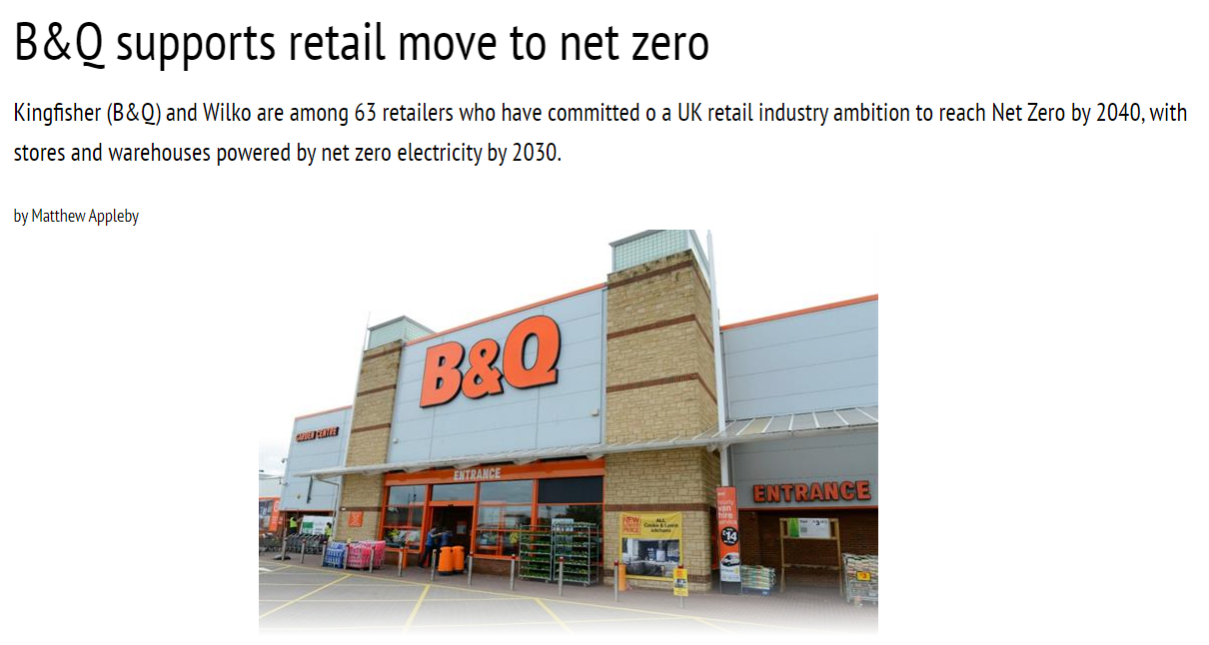
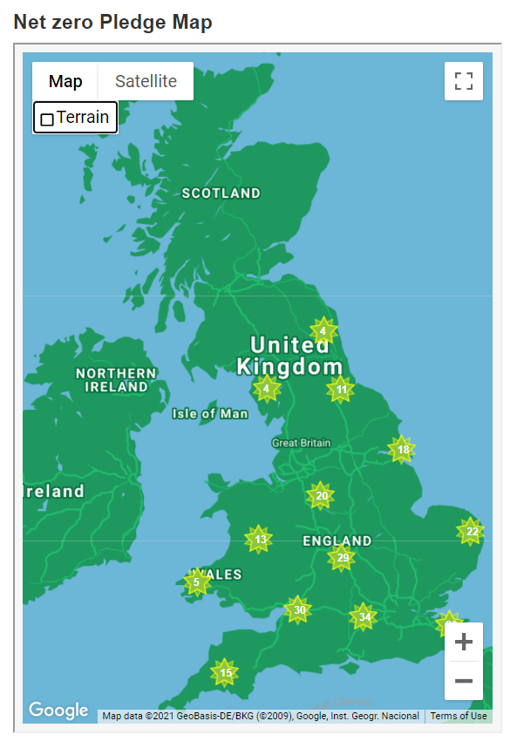
Net Zero commitments

Slide 5
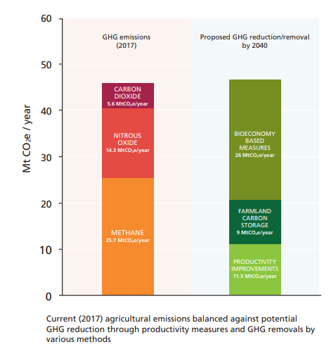
The problem – emissions sources
Graph shows emissions makeup (orange and red)
Green is proposed action
First step is to reduce emissions
What can we influence in horticulture?
Inputs
Energy
Productivity
Transport

Slide 6
Footsteps towards Net Zero
Sequester
Understand
Be more efficient
Measure
Alternative resources
Reduce inputs

Slide 7
Footsteps towards Net Zero
Sequester
Understand
Be more efficient
Measure
Alternative resources
Reduce inputs

Slide 8
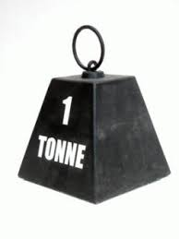
Visualise emissions
1 tonne CO₂e =
4,000 kWh electricity – 4 MW lighting for 1 hour
5,263 kWh gas burnt – 6 MW gas boiler for 53 minutes
1,400 litres diesel – 700 miles in an HGV
62.5 tonnes R401a refrigerant
178 tonnes Ammonium Nitrate production

Slide 9
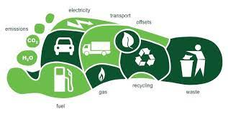
Inputs – what carbon emissions?
Identify inputs - # per year
Set boundaries
Determine CO₂ emissions - kg per #
Ask supplier
Calculate yourself
Create footprint
Ask ….
Are they significant compared to other inputs
What are the alternatives

Slide 10
Emissions sources
Reduce
Recycle
Re-use
Energy
Fertilisers
Pesticides
Plastics
Growing Media
Water
Wastes
Packaging
Etc.

Slide 11
Some good news – ‘natural’ decarbonisation
C. 200 gCO₂e per kWh supplied electricity
Reductions from stopping burning coal
Reductions because of increasing renewable energy

Slide 12
Renewable electricity
Renewables account for 76% of electricity generation
Notes:
Less important to growers but shows the direction of travel
National Grid Future Energy Scenarios show how heating could be electricfied
Gas is only as big as Solar
Additional 3 GW of wind power suggested

Slide 13
The effect

Slide 14
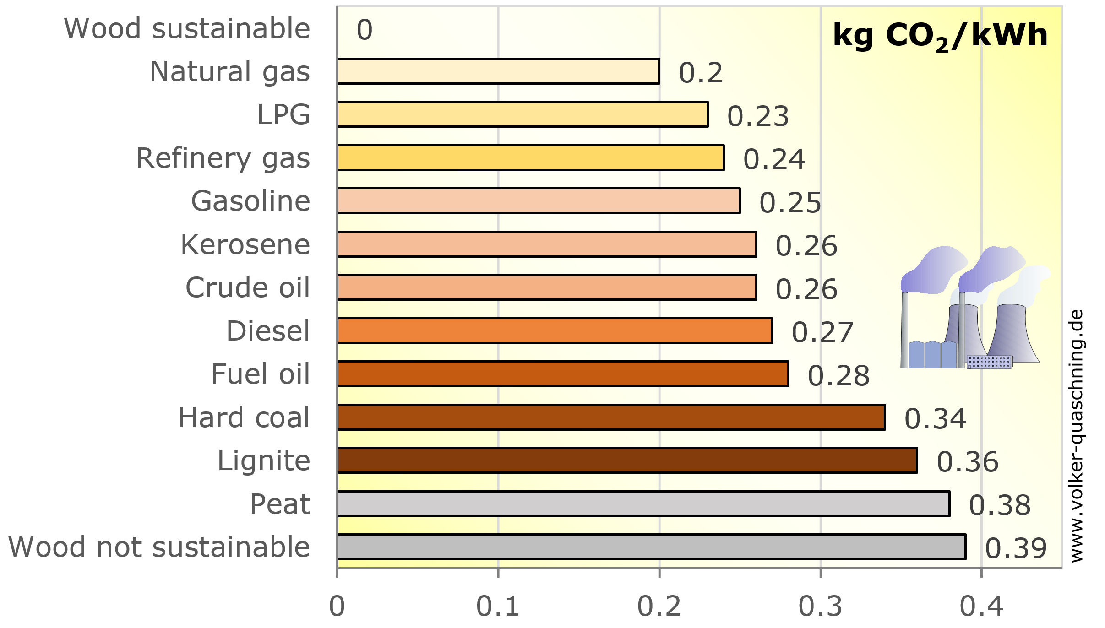
Heating fuels - Less good news
Gas and oil based heating fuels c. 190 – 220 gCO₂e per kWh
Unlikely to change much
Small biomethane influence
Possible hydrogen blend in the future <20%
How else to decarbonise heat in horticulture??
CHP
Heat Pumps
Biomass

Slide 15
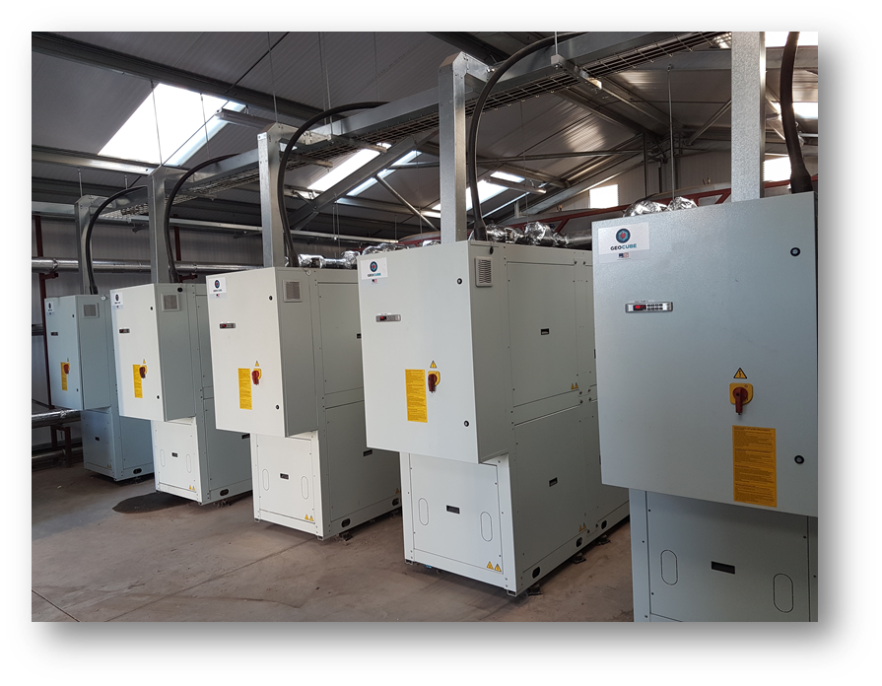
Heat Pumps – decarbonisation at work
1 kWh heat from gas network = 211 g CO₂ - 238 g CO₂
1 kWh heat delivered by heat pump = 40 g CO₂ – 67 g CO₂
Current grid electricity emissions are 200 g CO₂ /kWh
As grid electricity decarbonises further, heat pump emissions fall
Notes:
We should understand the reason for the drive to heat pumps
Carbon savings are huge (it’s solar energy after all)
We may have to compromise on temperatures

Slide 16
Examples

Slide 17
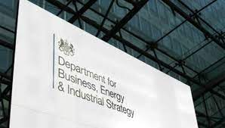
Policy drives
Disincentives to use fossil fuels
Increasing CCL Charges
Green Gas Levy
Carbon Price application
Positive drivers
RHI Extension
New Tariff Guarantees
Green Gas Support Scheme
Renewable Heat Grants
Green Heat Network Fund
Energy Innovation Fund
CCL/CCA extension
Notes:
https://ahdb.org.uk/growsave-budget-news
The positives are more numerous than the negatives BUT their likely impact is smaller
Trajectory was set pre Covid

Slide 18
The 10 point plan…
40 GW offshore wind
5 GW Hydrogen
Nuclear
Electric Vehicles
Public transport and cycling/walking
Jet Zero and green maritime
More efficient homes and public buildings
Carbon capture of 10 million tonnes
30,000 Ha tree planting?
London the centre of green finance

Slide 19
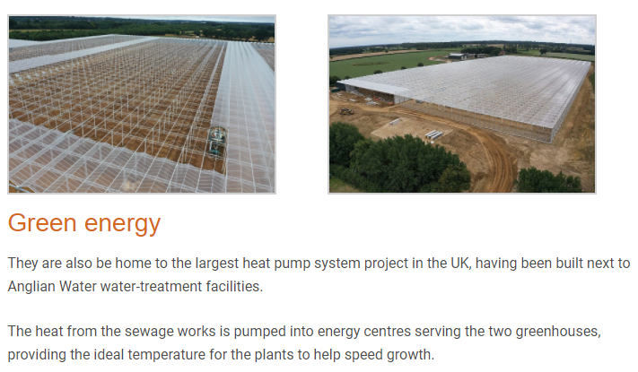
Decarbonising heat is the future
Heat sources are not just the ground or ground water…
Biomass has an important part to play
However, don’t forget the CO₂ enrichment challenge
Notes:
We should understand the reason for the drive to heat pumps
Carbon savings are huge (it’s solar energy after all)
We may have to compromise on temperatures

Slide 20
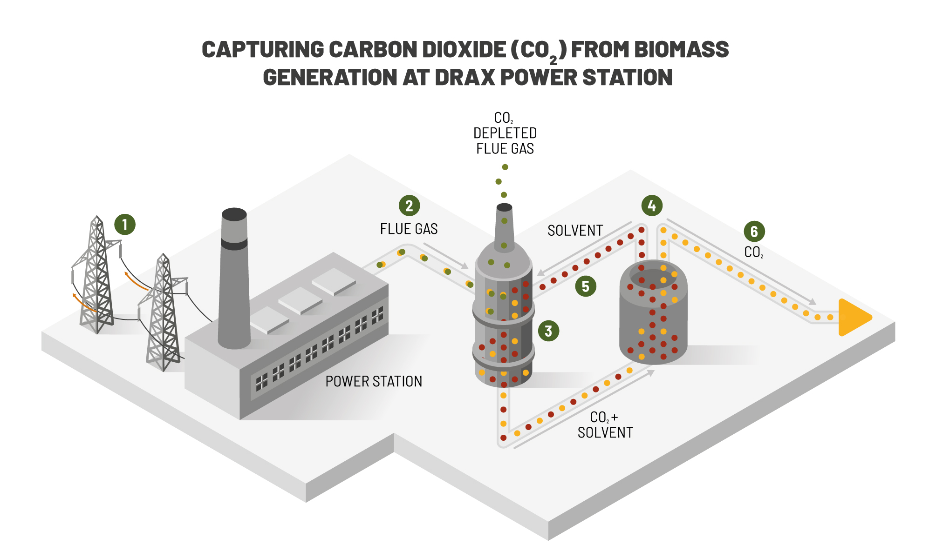
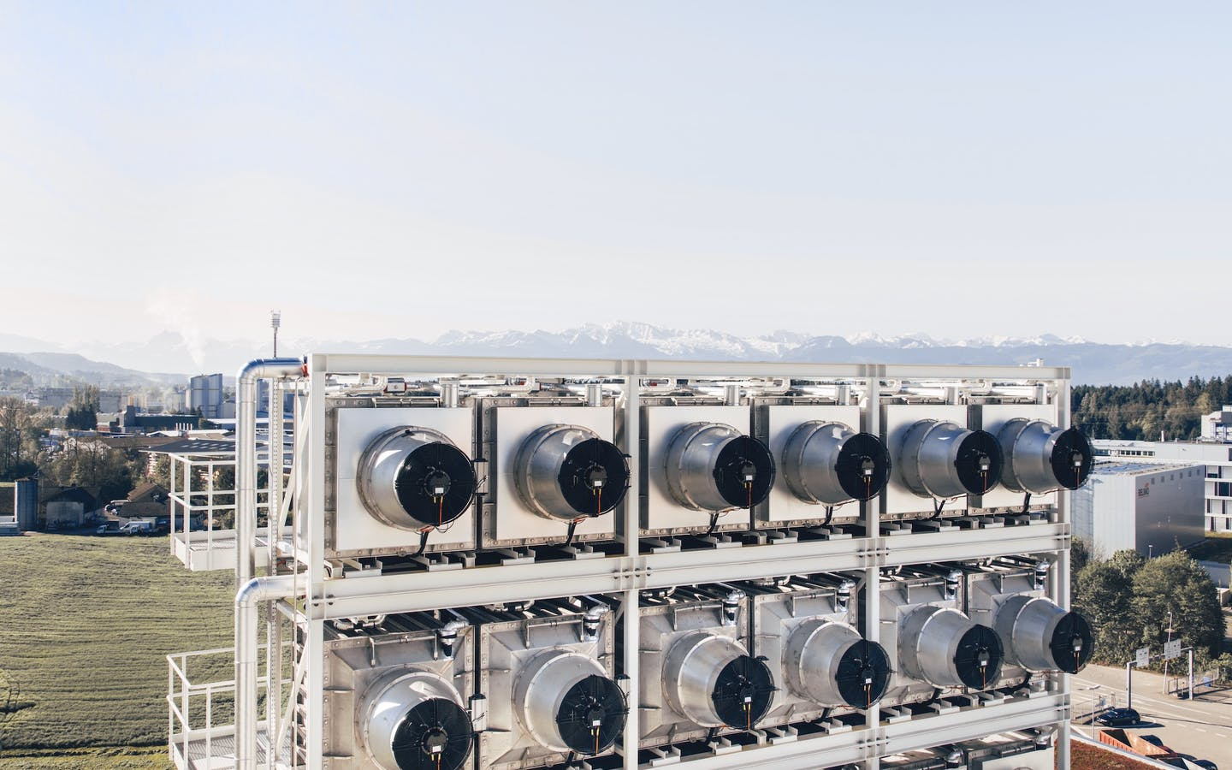
Carbon capture
£350m package of funding announced 22 July 2020
Nothing specifically for horticulture, but…
Aiming for transition from Gas to Hydrogen
Scaling up Carbon Capture and Storage technologies including Direct Air Capture
Notes:
Covid didn’t really change this but gave it a platform
We’re not just interested in reducing emissions but removing carbon too – essential for Net Zero
Hydrogen in the gas network…less CO2 for enrichment
https://www.gov.uk/government/news/pm-commits-350-million-to-fuel-green-recovery
https://www.drax.com/about-us/our-projects/bioenergy-carbon-capture-use-and-storage-beccs/

Slide 21
Consequential effects – e.g. refrigeration
Refrigerant | GWP CO₂e direct emissions
404A | 3922
434A | 3245
422A | 3143
407C | 1774
152A | 124
CO2 | 1
Ammonia | 0
Don’t forget indirect emissions
Manufacture
Disposal
Increased energy consumption?!

Slide 22
So what does it all mean?
Energy is an important CO₂ emission to tackle
Renewable electricity will soon dominate at grid and user levels
Greenhouse heating is moving towards heat pumps for new build and some retrofit
New sources of CO₂ need to be found to replace gas burning
Input efficiency is really important to reduce emissions at source
Reduced consumption
Renewable energy
Re-use resources

Slide 23
Questions?

